Slide 1

Discriminant Criterion
Discriminant criterion in mathematical formulation
trace(GrSbG)
r
trace(G SwG)
arg max
G
Between-class scatter matrix Sb
0
0
Within-class scatter matrix
SW
s-1s
The optimal transformation is given by solving a generalized
eigenvalue problem
•
w
b

Slide 2
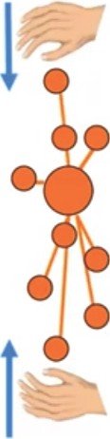



Within-Class Scatter (Sw)
Minimize the distance between
the their
samples of each class and
corresponding centre of that class.
OR, minimize the distance between each of the samples and the mean of its k nearest neighbours.
•
Within-dass distance

Slide 3



Within-Class Scatter (Sw)
Minimize the distance between
the their
samples of each class and
corresponding centre of that class.
OR, minimize the distance between each of the samples and the mean of its k nearest neighbours.
•
•
Within-dass distance

Slide 4
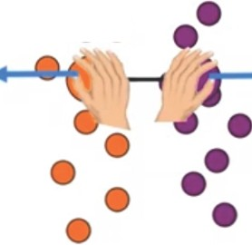

Between-C¹lass Scatter Matrix (Sb)
Maximize the distance between the different classes means or centres
•
••
OR, maximize the distance between the different classes centres and the mean (centre) of the whole data
c
SJJ = L(vi -x) (v, - x)T
1=1
Between-class distance
•

Slide 5
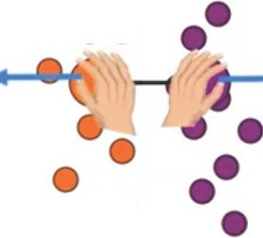

Between-Class Scatter Matirix (Sb)
Maximize the distance between the different classes means or centres
•
••
OR, maximize the distance between the different classes centres and the mean (centre) of the whole data
••
c
SJJ = L(vi - x) (vi - x)T
i= l
Between-class distance
•

Slide 6


Between- Class Scatter Matrix (Sb)
Maximize the distance between the different classes means or centres
• ••
•• ••
•
OR, maximize the distance between the different classes centres and the mean (centre) of the whole data
•• ••••
• •
•
•
c
Su = L(v; - x) (v₁ - x )T
t=l
Between-class distance
•

Slide 7


Between- Class Scatter Matirix (Sb)
Maximize the distance between the different classes means or centres
• ••
•••
••
OR, maximize the distance between the different classes centres and the mean (centre) of the whole data
••• • •
••
••
•
c
Su = L(v; -x) (v, - x)T
i=l
Between-class distance
•

Slide 8

Linear Discriminant Analysis (LOA)
• ••
Instead of projecting the data along the
•• ••
directions of maximum variance, LOA
••• ..
attempts to project the data in a manner
that maximizes between-class distance
and minimizes within-class distance .
• •
• •
•••
To do that we need to construct wi hin­
class scatter (Sw), and between-class
•
scatter (Sb)·
•

Slide 9

PCA - Disadvantages
PCA does not take the class label information into considerations. Thus, the projection of PCA might not be the best tool for classification problems as including the class label when computing the projection matrix may significantly enhance the classification results.
When projecting the data to achieve dimensionality reduction, we only keep a certain number of principal components , but how to choose the number of retained components is hard to determine as it is a problem dependent task.
Lets have a look at LOA
•

Slide 10

PCA -Advantages
1·n situations when theinformation is liberally dispersed amongst the originalfeature set, using PCA will consolidate this information in an effective manner and allow us to use few principalcomponents only to represent most of the information contained within the original data.
The features produced by PCA are mutually uncorrelated,thus minimizing, the information
redundancy.
PCA appears to do a good job, but is
•
PCA a good critenon for classification?

Slide 11


p
,---_J
----,
PCA Steps
r
N
N x P
Suppose that we have a data matrix X , with each row representing a sample xi, i.e., X [x ₁; x₂; ....;xN]-
N
l
x = Lxi
Step1: Find the mean
i=1
Step2: Remove the mean from the data X = X - x
N x k
Step3: Form the covariance matrix S = XT X
Step4: Compute the eigenvalues and the eigenvectors U of S (p><p)
Steps: Use only the first k vectors (k <= p)
•
x P><k
=
N><k
N><P
u

Slide 12

2-variables Covariance Matrix
Correlation
S = [sf S1z]
2
S21 S2
The most familiar measure of relationship between two variables is the Pearson Correlation Coefficient. This is simply obtained by diving the covariance of the two variables by the product of their standard deviations.
cov (X , Y)
corr (X , Y)
)var (X ) .Jvar (Y)
Correlation between 1st and 2nd variable is r = -^{S12}-
•
If I want to make 1st and 2nd variables uncorrelated then make S12 =S21 =zero

Slide 13

2-variables Covariance Matrix
Correlation
S = [sf S1z]
2
S21 S2
The most familiar measure of relationship between two variables is the Pearson Correlation Coefficient. This is simply obtained by diving the covariance of the two variables by the product of their standard deviations.
cov (X , Y)
std ( )std ( Y)
corr (X , Y)
Correlation between 1st and 2nd variable is r = -^{S12}-
•
If I want to make 1st and 2nd variables uncorrelated then make S12 =S21 =zero

Slide 14
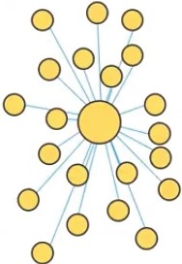

Variance & Covariance
To understand PCA, lets remember the difference between Variance and Covariance, and how Correlation is related these terms.
Variance is a measure of the spread of the data
s 2 = Lr=l (Xi - x)²
n - 1
Covariance, on the other hand, tells us how much the two different variables (or Dimensions) vary from the mean with respect to each other
•
1
cov(x , Y ) _
"' (X · - X )
( Y.· - r¥)
-
4'.. t = l L
n -
1
L

Slide 15
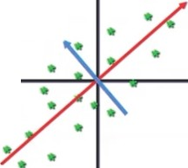

Principal Component Analysis (PCA)
PCA is a multivariate technique in which a number of related variables are transformed into (hopefully, a smaller) set of uncorrelated variables.
• •
Second principal component
First principal component
•
Original axes
•
•
•
Data points

Slide 16
sepal length
sepal width
petal length
petal width
principal component 1
princial component 2
0
-0.900681
1.032057
-1.341272
-1.312977
PCA
(2 components)
"'
0
-2.264542
0.505704
1 | -1.143017 | -0.124958 | -1.341272 | -1.312977
2 | -1.385353 | 0.337848 | -1.398138 | -1.312977
3 | -1.506521 | 0.106445 | -1.284407 | -1.312977
1
-2.086426
-0.655405
2
-2.367950
-0.318477
3
-2.304197
-0.575368
4
-1.021849
1.263460
-1.341272
-1.312977
4
-2.388777
0.674767

Slide 17
WELCOME

